Slide 1
MODULE-II
Module III | DESIGN ENGINEERING AND METRICS | (09Period)
Design Engineering: Design within the context of Software Engineering, The Design process, Design concepts, Software Architecture, Architectural Styles, Architectural design, Pattern based Design-Design Patterns, Pattern based software design. Process and Project Metrics: Metrics in the process and project domains, Software Measurement, Metrics for software quality.

Slide 2
DESIGN ENGINEERING
Beginning once software requirements have been analyzed and modeled, software design is the last software engineering action within the modeling activity and sets the stage for construction.
The architectural design defines the relationship between major structural elements of the software, the architectural styles and design patterns that can be used to achieve the requirements defined for the system, and the constraints that affect the way in which architecture can be implemented.
The architectural design representation—the framework of a computer-based system—is derived from the requirements model.

Slide 3
DESIGN ENGINEERING
The interface design describes how the software communicates with systems that interoperate with it, and with humans who use it.
An interface implies a flow of information and a specific type of behavior.
Therefore, usage scenarios and behavioral models provide much of the information required for interface design.
The importance of software design can be stated with a single word—quality.
Design is the place where quality is fostered in software engineering. Design provides you with representations of software that can be assessed for quality. Design is the only way that you can accurately translate stakeholder‘s requirements into a finished software product or system.

Slide 4
DESIGN PROCESS
Software design is an iterative process through which requirements are translated into a blueprint for constructing the software. Initially, the blueprint depicts a holistic view of software.
The design is represented at a high level of abstraction ,a level that can be directly traced to the specific system objective and more detailed data, functional, and behavioral requirements.
As design iterations occur, subsequent refinement leads to design representations at much lower levels of abstraction. These can still be traced to requirements, but the connection is more subtle.
The design phase of software development deals with transforming the customer requirements as described in the SRS documents into a form implementable using a programming language.

Slide 5
DESIGN PROCESS
The software design process can be divided into the following three levels of phases of design:
Interface Design
Architectural Design
Detailed Design

Slide 6
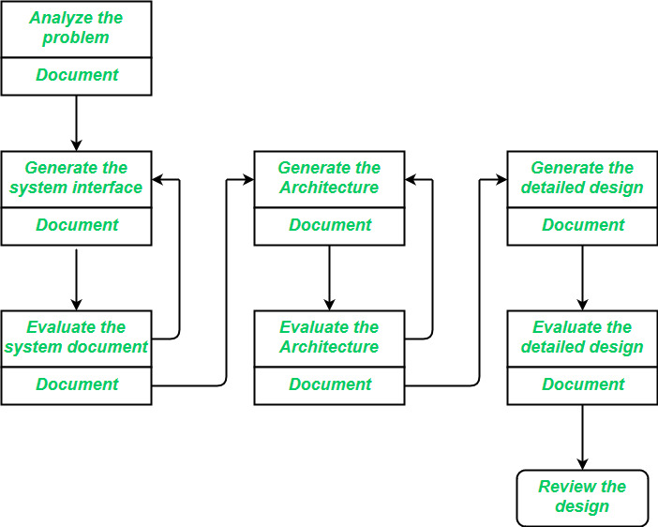
DESIGN PROCESS

Slide 7
DESIGN PROCESS
Interface Design:
Interface design is the specification of the interaction between a system and its environment.
This phase proceeds at a high level of abstraction with respect to the inner workings of the system i.e, during interface design, the internal of the systems are completely ignored and the system is treated as a black box.
Attention is focused on the dialogue between the target system and the users, devices, and other systems with which it interacts.
The design problem statement produced during the problem analysis step should identify the people, other systems, and devices which are collectively called agents.

Slide 8
DESIGN PROCESS
Architectural Design:
Architectural design is the specification of the major components of a system, their responsibilities, properties, interfaces, and the relationships and interactions between them.
In architectural design, the overall structure of the system is chosen, but the internal details of major components are ignored.
Detailed Design:
Design is the specification of the internal elements of all major system components, their properties, relationships, processing, and often their algorithms and the data structures.

Slide 9
DESIGN CONCEPT
Concepts are defined as a principle idea or invention that comes into our mind or in thought to understand something.
The software design concept simply means the idea or principle behind the design. It describes how you plan to solve the problem of designing software, the logic, or thinking behind how you will design software.
It allows the software engineer to create the model of the system or software or product that is to be developed or built.
The software design concept provides a supporting and essential structure or model for developing the right software.

Slide 10
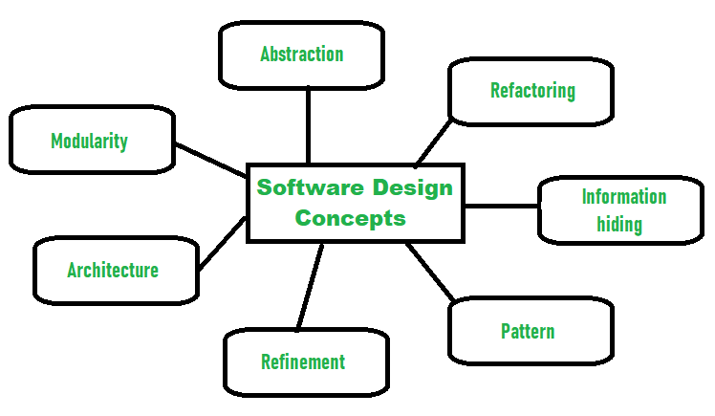
DESIGN CONCEPT

Slide 11
DESIGN CONCEPT
Abstraction- hide Irrelevant data
Abstraction simply means to hide the details to reduce complexity and increases efficiency or quality.
Different levels of Abstraction are necessary and must be applied at each stage of the design process so that any error that is present can be removed to increase the efficiency of the software solution and to refine the software solution.
The solution should be described in broad ways that cover a wide range of different things at a higher level of abstraction and a more detailed description of a solution of software should be given at the lower level of abstraction.

Slide 12
DESIGN CONCEPT
Modularity- subdivide the system
Modularity simply means dividing the system or project into smaller parts to reduce the complexity of the system or project.
In the same way, modularity in design means subdividing a system into smaller parts so that these parts can be created independently and then use these parts in different systems to perform different functions.
It is necessary to divide the software into components known as modules because nowadays there are different software available like Monolithic software that is hard to grasp for software engineers.
So, modularity in design has now become a trend and is also important. If the system contains fewer components then it would mean the system is complex which requires a lot of effort (cost) but if we are able to divide the system into components then the cost would be small.

Slide 13
DESIGN CONCEPT
Architecture- design a structure of something
Architecture simply means a technique to design a structure of something.
Architecture in designing software is a concept that focuses on various elements and the data of the structure. These components interact with each other and use the data of the structure in architecture.
Refinement- removes impurities
Refinement simply means to refine something to remove any impurities if present and increase the quality.
The refinement concept of software design is actually a process of developing or presenting the software or system in a detailed manner that means to elaborate a system or software.
Refinement is very necessary to find out any error if present and then to reduce it.

Slide 14
DESIGN CONCEPT
Pattern- a repeated form
The pattern simply means a repeated form or design in which the same shape is repeated several times to form a pattern.
The pattern in the design process means the repetition of a solution to a common recurring problem within a certain context.
Information Hiding- hide the information
Information hiding simply means to hide the information so that it cannot be accessed by an unwanted party.
In software design, information hiding is achieved by designing the modules in a manner that the information gathered or contained in one module is hidden and can’t be accessed by any other modules.

Slide 15
DESIGN CONCEPT
Refactoring- reconstruct something
Refactoring simply means reconstructing something in such a way that it does not affect the behavior of any other features.
Refactoring in software design means reconstructing the design to reduce complexity and simplify it without affecting the behavior or its functions.
Fowler has defined refactoring as “the process of changing a software system in a way that it won’t affect the behavior of the design and improves the internal structure”.

Slide 16
SOFTWARE ARCHITECTURE
The architecture of a system describes its major components, their relationships (structures), and how they interact with each other.
Software architecture and design includes several contributory factors such as Business strategy, quality attributes, human dynamics, design, and IT environment.

Slide 17
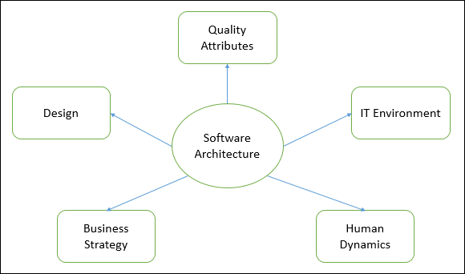
SOFTWARE ARCHITECTURE

Slide 18
SOFTWARE ARCHITECTURE
Architecture serves as a blueprint for a system. It provides an abstraction to manage the system complexity and establish a communication and coordination mechanism among components.
It defines a structured solution to meet all the technical and operational requirements, while optimizing the common quality attributes like performance and security.
Further, it involves a set of significant decisions about the organization related to software development and each of these decisions can have a considerable impact on quality, maintainability, performance, and the overall success of the final product.

Slide 19
SOFTWARE ARCHITECTURE
Some of the other goals are as follows −
Expose the structure of the system, but hide its implementation details.
Realize all the use-cases and scenarios.
Try to address the requirements of various stakeholders.
Handle both functional and quality requirements.
Reduce the goal of ownership and improve the organization’s market position.
Improve quality and functionality offered by the system.

Slide 20
SOFTWARE ARCHITECTURE
Limitations
Software architecture is still an emerging discipline within software engineering. It has the following limitations −
Lack of tools and standardized ways to represent architecture.
Lack of analysis methods to predict whether architecture will result in an implementation that meets the requirements.
Lack of awareness of the importance of architectural design to software development.
Lack of understanding of the role of software architect and poor communication among stakeholders.

Slide 21
SOFTWARE ARCHITECTURE
Role of Software Architect
A Software Architect provides a solution that the technical team can create and design for the entire application. A software architect should have expertise in the following areas −
Design Expertise
Expert in software design, including diverse methods and approaches such as object-oriented design, event-driven design, etc.
Lead the development team and coordinate the development efforts for the integrity of the design.

Slide 22
SOFTWARE ARCHITECTURE
Domain Expertise
Expert on the system being developed and plan for software evolution.
Assist in the requirement investigation process, assuring completeness and consistency.
Coordinate the definition of domain model for the system being developed.
Technology Expertise
Expert on available technologies that helps in the implementation of the system.
Coordinate the selection of programming language, framework, platforms, databases, etc.

Slide 23
SOFTWARE ARCHITECTURE
Methodological Expertise
Expert on software development methodologies that may be adopted during SDLC (Software Development Life Cycle).
Choose the appropriate approaches for development that helps the entire team.
Hidden Role of Software Architect
Facilitates the technical work among team members and reinforcing the trust relationship in the team.
Information specialist who shares knowledge and has vast experience.
Protect the team members from external forces that would distract them and bring less value to the project.

Slide 24
SOFTWARE ARCHITECTURE
Deliverables of the Architect
A clear, complete, consistent, and achievable set of functional goals
A functional description of the system, with at least two layers of decomposition.

Slide 25
ARCHITECTURAL STYLES
A crucial component of software engineering is software architecture, which establishes the high-level organization of a system. It includes how parts are designed, how they work together, and the guiding ideas behind how they are put together.
Software system designers can use architectural styles as templates and guides while creating software. This investigation will examine several software engineering architectural styles in-depth, particularly their traits, applications, and historical development.

Slide 26
ARCHITECTURAL STYLES
A set of components (eg: a database, computational modules) that will perform a function required by the system.
The set of connectors will help in coordination, communication, and cooperation between the components.
Conditions that how components can be integrated to form the system.
Semantic models that help the designer to understand the overall properties of the system.
The use of architectural styles is to establish a structure for all the components of the system.

Slide 27
Types
Monolithic Architecture
Layered Architecture
Architecture of Client-Server
Microservices Foundation
Event-Driven Architecture
Service-Oriented Architecture
Architecture Based on Components
Peer-to-Peer Architecture
Architecture in N-Tiers
Cloud-Based Architecture

Slide 28
ARCHITECTURAL DESIGN
The software needs an architectural design to represent the design of the software. IEEE defines architectural design as “the process of defining a collection of hardware and software components and their interfaces to establish the framework for the development of a computer system.” The software that is built for computer-based systems can exhibit one of these many architectural styles.
Taxonomy of Architectural Styles
Data centered architectures
Data flow architectures
Call and Return architectures
Object Oriented architecture
Layered architecture

Slide 29
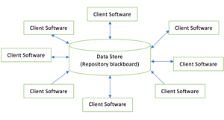
Data centered architectures

Slide 30
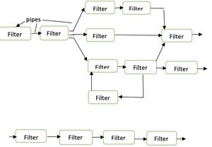
Data flow architectures

Slide 31
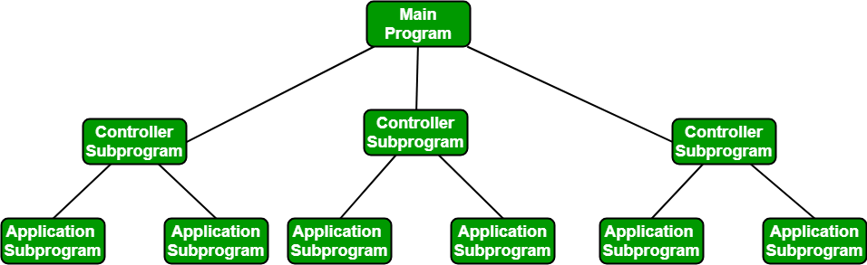
Call and Return architectures

Slide 32
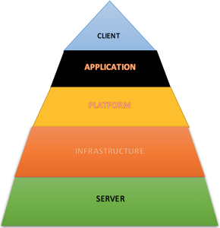
Layered architecture
A number of different layers are defined with each layer performing a well-defined set of operations. Each layer will do some operations that becomes closer to machine instruction set progressively.
At the outer layer, components will receive the user interface operations and at the inner layers, components will perform the operating system interfacing(communication and coordination with OS)
Intermediate layers to utility services and application software functions.
One common example of this architectural style is OSI-ISO (Open Systems Interconnection-International Organisation for Standardisation) communication system.

Slide 33
SOFTWARE DESIGN PATTERNS
Software design patterns are important tools developers, providing proven solutions to common problems encountered during software development. Developers can create more robust, maintainable, and scalable software systems by understanding and applying these patterns.
Key Characteristics of Design Patterns
Reusability: Patterns can be applied to different projects and problems, saving time and effort in solving similar issues.
Standardization: They provide a shared language and understanding among developers, helping in communication and collaboration.
Efficiency: By using these popular patterns, developers can avoid finding the solution to same recurring problems, which leads to faster development.
Flexibility: Patterns are abstract solutions/templates that can be adapted to fit various scenarios and requirements.

Slide 34
Types of Software Design Patterns
Creational Design Pattern
Structural Design Pattern
Behavioral Design Pattern

Slide 35
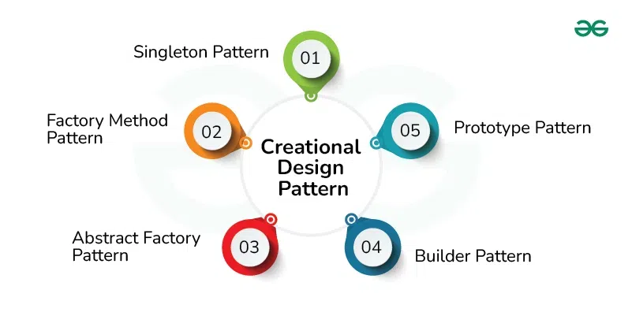
Creational Design Patterns
Creational Design Patterns focus on the process of object creation or problems related to object creation. They help in making a system independent of how its objects are created, composed and represented.
Types:
Factory Method
Abstract Factory Method
Singleton Method
Builder Method

Slide 36
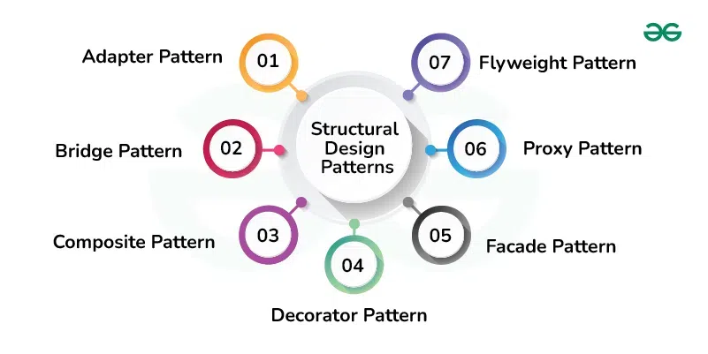
Structural Design Patterns
Structural Design Patterns solves problems related to how classes and objects are composed/assembled to form larger structures which are efficient and flexible in nature. Structural class patterns use inheritance to compose interfaces or implementations.

Slide 37
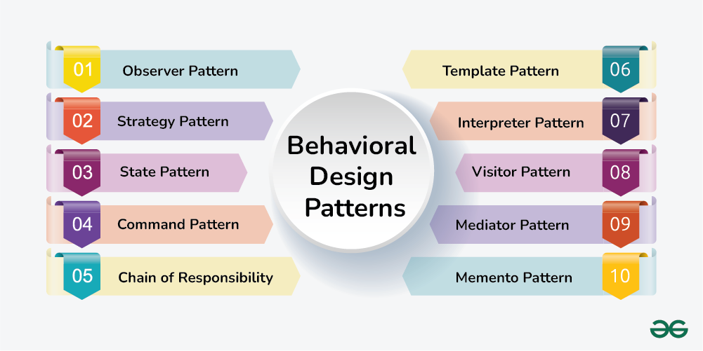
Behavioral Design Patterns
Behavioral Patterns are concerned with algorithms and the assignment of responsibilities between objects. Behavioral patterns describe not just patterns of objects or classes but also the patterns of communication between them. These patterns characterize complex control flow that’s difficult to follow at run-time.

Slide 38
Advantages of Pattern Designing
Reusable Solutions: Pattern designing emphasizes creating solutions that are not specific to a particular project but can be reused across various projects. This promotes code reusability and consistency.
Scalability: Patterns provide a structured approach to design, making it easier to scale a system by applying well-defined solutions to new components or modules. This promotes a consistent architecture across the entire application.
Abstraction and Communication: Patterns use a common vocabulary and abstraction level, making it easier for developers to communicate and understand design decisions. This facilitates collaboration within a development team.
Maintainability: Design patterns contribute to a modular and organized codebase, making it easier to maintain and update. Changes to specific patterns can be localized without affecting the entire system.
Speeds Up Development: Patterns offer ready-made solutions to common problems, speeding up the development process. Developers can focus on application-specific logic rather than spending time on low-level design challenges.
Tool for Problem Solving: Pattern designing serves as a tool for problem-solving in software development. It provides a set of proven strategies that developers can apply to overcome challenges encountered in various stages of the development lifecycle.

Slide 39
Disadvantages of Pattern Designing
Learning Curve: Understanding and correctly applying design patterns require experience and knowledge. Developers new to design patterns may find it challenging to grasp the concepts initially.
Over engineering: In some cases, applying design patterns without a clear need or understanding of the problem may result in overengineering. This can lead to unnecessary complexity in the code.
Rigidity: In certain situations, design patterns may introduce rigidity to the code, making it less adaptable to changes. Overreliance on patterns without considering the specific context can hinder flexibility.
Applicability Concerns: Not all design patterns are applicable to every situation. Some patterns may not fit well with the architecture or requirements of a particular system, leading to suboptimal solutions.
Maintenance Challenges: While design patterns promote maintainability, they can also introduce challenges. Over time, if patterns are not applied consistently or if the system evolves in unexpected ways, maintenance may become difficult.

Slide 40
PROCESS AND PROJECT METRICS
Measurement enables us to gain insight into the process and the project by providing a mechanism for objective evaluation.
Measurement can be applied to the software process with the intent of improving it on a continuous basis.
Measurement can be used throughout a software project to assist in estimation, quality control, productivity assessment, and project control.
Software process and project metrics are quantitative measures that enable you to gain insight into the efficacy of the software process and the projects that are conducted using the process as a framework
Metrics are also used to pinpoint problem areas so that remedies can be developed and the software process can be improved.

Slide 41
METRICS IN THE PROCESS AND PROJECT DOMAINS
Project metric intention is to provide a set of process indicators that lead to long-term software process improvement. Project metrics enable a software project manager to
(1) Assess the status of an ongoing project,
(2) track potential risks,
(3) uncover problem areas before they go “critical,”
(4) Adjust work flow or tasks, and
(5) Evaluate the project team’s ability to control quality of software work products.

Slide 42
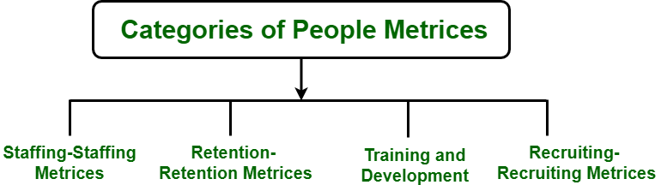
People Metrics
People metrics quantify useful attributes of those generating the products using the available processes, methods, and tools.
These metrics tell you about the attributes like turnover rates, productivity, and absenteeism.

Slide 43
Process Metrics
Process Metrics are the measures of the development process that create a body of software.
A common example of a process metric is the length of time that the process of software creation tasks.
process metrics can be used to estimate, monitor, and improve the reliability and quality of software.
ISO- 9000 certification, or “Quality Management Standards“, is the generic reference for a family of standards developed by the International Standard Organization (ISO).

Slide 44
SOFTWARE MEASUREMENT
A measurement is a manifestation of the size, quantity, amount, or dimension of a particular attribute of a product or process.
Software measurement is a titrate impute of a characteristic of a software product or the software process.
Classification of Software Measurement:
There are 2 types of software measurement:
Direct Measurement: In direct measurement, the product, process, or thing is measured directly using a standard scale.
Indirect Measurement: In indirect measurement, the quantity or quality to be measured is measured using related parameters i.e. by use of reference.

Slide 45
Software Measurement Principles
Formulation: The derivation of software measures and metrics appropriate for the representation of the software that is being considered.
Collection: The mechanism used to accumulate data required to derive the formulated metrics.
Analysis: The computation of metrics and the application of mathematical tools.
Interpretation: The evaluation of metrics results in insight into the quality of the representation.
Feedback: Recommendation derived from the interpretation of product metrics transmitted to the software team.

Slide 46
QUALITY METRICS
In Software engineering Software Quality Assurance (SAQ) assures the quality of the software. A set of activities in SAQ is continuously applied throughout the software process.
Code Quality
Reliability
Performance
Usability
Correctness
Maintainability
Integrity
Security

